Slide 1
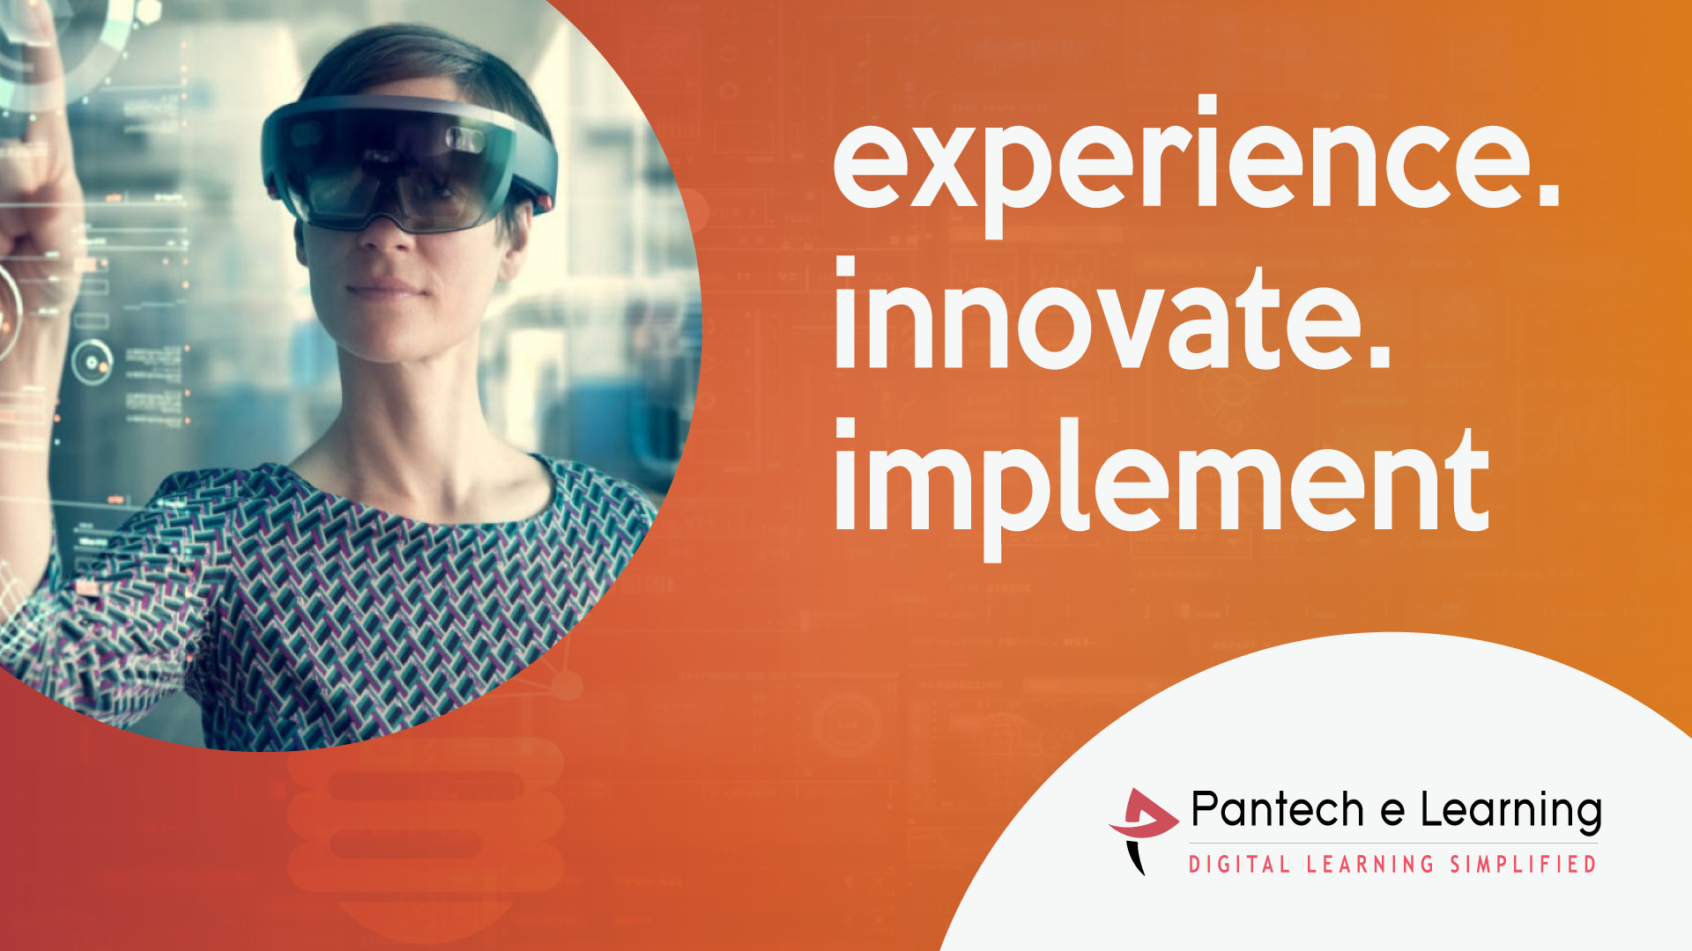

Slide 2
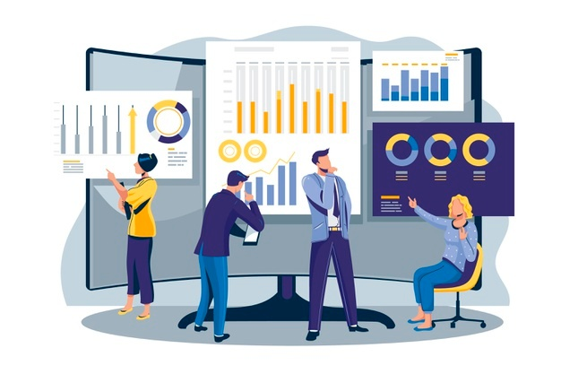
30 Days Python Master Class
Day1 : Python
Time: 6.00 PM IST
Free Registration

Slide 3
Python Master Class
Handbook

Slide 4
NANDHINI.S
Exp: 5 Yrs
Expert in
Python Developer on Machine Learning
Deep learning with computer vision
Matlab – Image Processing
Autonomous Car design using ROS with LIDAR
Language – Python , Java , HTML ,CSS.
Tools – ANACONDA NAVIGATOR, JUPYTER NOTEBOOK,
GOOGLE COLAB.
Graduation : BE – ECE | 2011

Slide 5
Pantech?
Educational Equipment Manufacturer
IoT, AI, Robotics,Autonomous Robot
Microprocessor/Microcontroller
DSP,VLSI, Embedded System
Power Electronics & Drives, Fuel Cell Trainer Kit
Renewable Energy Lab, Electric Vehicle Lab
Technical Training
DIY Project

Slide 6

What is Master Class ?
👍 This is the 30 Days Industrial Learning Activity.
👍 Its Online YouTube Live Class
👍 If you Invest 45 minutes daily, U will become Master in Data Science
👍 You will get FREE E-Certificate
Webinar Participation Certificate
“Learning is the beginning of wealth.
Searching & Learning is where the miracle process all begins.” …………….Jim Rohn

Slide 7
Our Vision
Help 10 Million Students to Learn the Technology in Easy Way

Slide 8

Associate Partner for this Master Class
https://apssdc.in/home/

Slide 9
What U will Learn from 30 Days Data Science & Analytics Master Class

Slide 10
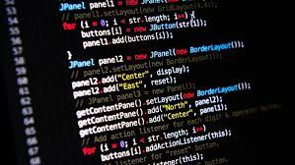
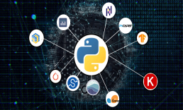
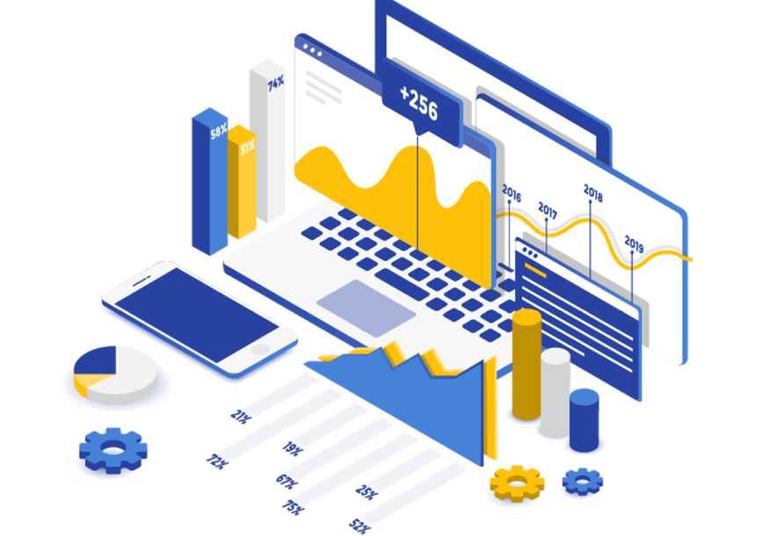
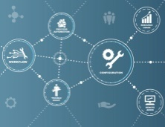
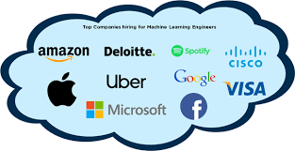
Python Learning Plan
01
02
03
04
05
Library
Python
Analytics
Analytics
Industry Project
Introduction To Python and Python Data Structures
Pandas
Numpy
MatplotLib
Cborn, SKLearn Lib
Collab
Distribution
Visualization
Aggregation
Statistics
Distribution Function
Project Building

Slide 11
Day wise Learning Plan
Day -1 : Introduction to Python
Day -2: Python – Tools|Syntaxes & Data Structures
Day -3: Python – Dictionaries,Date and Time
Day -4: Python – MySql
Day -5: Pandas library – Introduction
Day -6: Pandas library – Data Structures
Day -7: Numpy library – Introduction
Day -8: Numpy library – Array Manipulations, Mathematical Functions
Day -9: Matplotlib , Histogram Using Matplotlib | I/O With Numpy
Day -10: Matplotlib Library - Introduction , Pyplot API | Types Of Plots
Day -11: Seaborn Library
Day -12: SKLearn Library
Day -13: Python – Date and Time , Data Wrangling.
Day -14: Python – Data Cleansing
Day -15: Python – Word Tokenization , Stemming and Lammetization.

Slide 12
Day wise Learning Plan
Day -16: Python – Data Visualization
Day -17: Python – Statistical Analysis
Day -18: Python – Types Of Distribution
Day -19: Python – Correlation ,Chi-Square Test , Linear Regression
Day -20: Keras library – Introduction.
Day -21: Stock Price Prediction With Machine Learning LSTM RNN
Day -22: People’s behaviour in chat message using NLP NLP
Day -23: Gaming In Python
Day -24: Chatbot creation in Python NLP
Day -25: Electricity Price Prediction Using ML Random Forest Regressor
Day -26: Diamond Price Prediction Using Python Linear Regression
Day -27: Book Recommendation System KNN
Day -28: Image Classification Using CNN CNN
Day -29: Titanic Survival Analysis Using ML Logistic Regression
Day -30: Blockchain in Python

Slide 13
List of Projects for Demo in YouTube Live
Stock Price Prediction With Machine Learning
People’s behaviour in chat message using NLP
Gaming In Python
Chatbot creation in Python
Electricity Price Prediction Using ML
Diamond Price Prediction Using Python
Book Recommendation System
Image Classification Using CNN
Titanic Survival Analysis Using ML
Blockchain in Python
All Projects in Jupyter Notebook

Slide 14
What you will get from this Free 30 Days Master Class?
You can attend YouTube Live Class
Free E-Certificate ( WEBINAR PARTICIPATION CERTIFICATE)

Slide 15
How to mark your Attendance in YouTube Live Class?
Ans : During the Live Class, organizer will post Google Form link in Live Chat. The Participants should submit the from on daily basis. Minimum 25 Days Attendance is Required to get Free Master Class Participation Certificate.
Note : The Link will be available during the Live. From the LIVE Class date, the live video will get removed from the YouTube in 3 days.

Slide 16
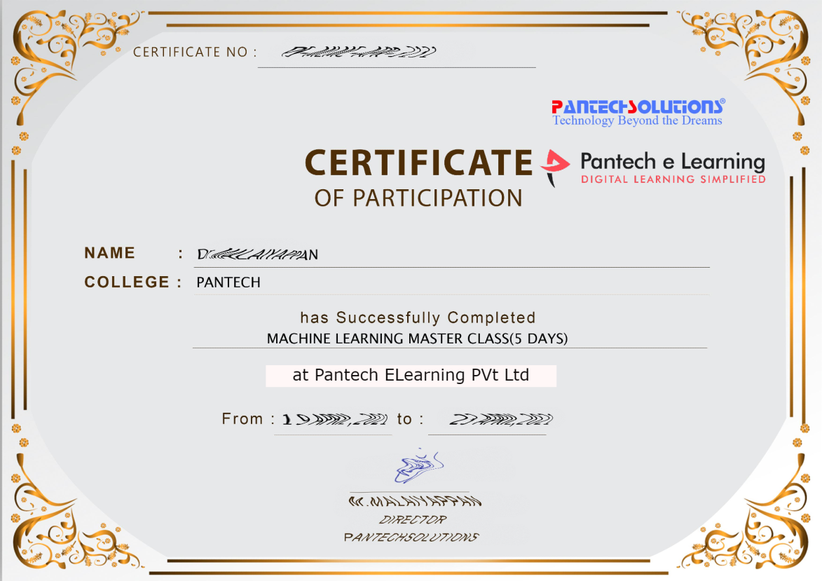

Sample Webinar Participation Certificate?

Slide 17
https://www.pantechelearning.com/data-science-master-class/
On Demand
You can get chance to apply 1 Month Internship on Data Science & Analytics Master Class

Slide 18
What is Internship????
Learn
Practice
Verify
Get Certified
Grow

Slide 19
Free Master Class DSA | 1 Month Internship on DSA
Master Class Participation Certificate | Internship Completion Certificate
Minimum 25 Class should attend YouTube Live | Recorded Class Link will be provided. – LMS Portal Access
YouTube Live Mandatory | Your Choice. You can attend Live or else You can watch Recorded Class in LMS Portal
All Projects Demo class in YouTube Live | Step by Step Video Explanation Content in LMS Portal
Access : 3 Days | VIP WhatsApp Group Support
 | You Can Download All PPTs
 | 4 Nos of Hackathon Class in Zoom Live. The Recording also will be provided
 | You Can Download All Project Files
 | Mentor will guide you to finish 10 Projects
 | Access : 60 Days

Slide 20
Pantech will make you to Create 10 Projects in Data Science & Analytics in 30 Days
Objective of this 30 Days Master Class

Slide 21
1 Month Internship in Data Science
INTERNSHIP E-Certificate(30Days Internship on Data Science Engineering)
Highly organized Video content
Download All Files
Download PPTs
Assignments
Flexible Time.
Access Period: 60Days from the date of payment

Slide 22
What You Will Get???
Complete Project Files
30 Days Learning Activity
Data Science Core Concepts
10 + Projects
Project PPT
Spatial Data Science For Covid-19 Disease Prediction
Parkinson’s Disease Prediction-XGBoost Classifier
House Price Prediction-Random Forest Regression
Customer Segmentation Using ML-K-Means Clustering
Home Loan Prediction-Decision Tree Classifier
Spam Classification-NLP
Hand Written Digit Recognition Using Python-CNN
Churn Prediction-Deep Learning
Crop Yield Prediction
Ground water level prediction
Video Class Access for 2 Months
Get chance to Enroll 1-Month Internship on demand

Slide 23
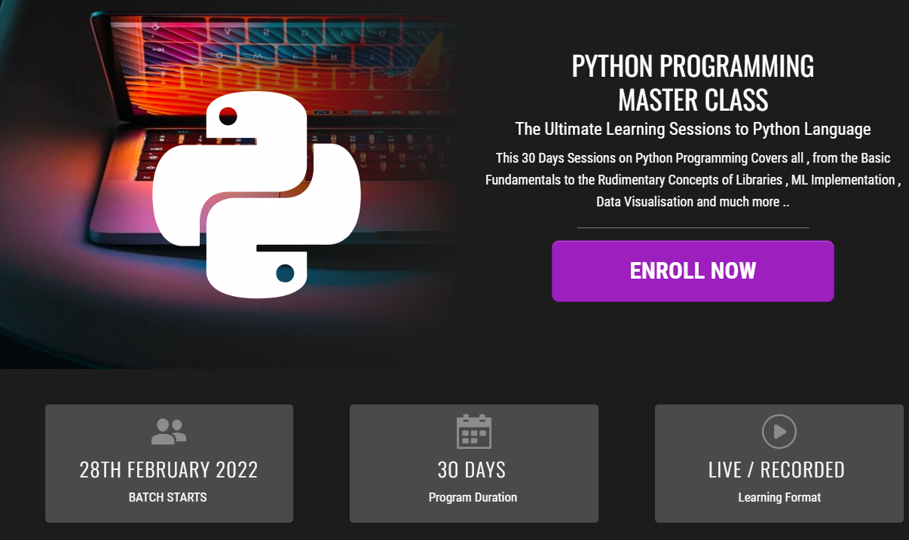
How to join in 1 month Internship
https://www.pantechelearning.com/pymc-internship/
Coupon Code: PYMC

Slide 24
Women’s Christian College
Department Of Computer Applications.
Python Programming For Data Science.
Convenor:
Ms.Sylvia Mary D
(HOD)
(Department Of Computer Applications)

Slide 25
Webinar On Python Programming For Data Science

Slide 26
Overview of Pantech eLearning
Profile
Training
01
04
02
R & D
03
Services
Established on 2004 7 Wings 100+ Team Size
2000 + Workshops 300+ FDP’s 12.5 Lacs + Students
Industrial Design Services Lab Equipment Manufacturer Working on Funded Projects
Workshops, FDP’s Internships, Value Added Courses Online Training Project Guidance

Slide 27
Follow us on:
Instagram--https://instagram.com/pantechelearning?igshid=1fohp030onteu
Telegram--https://t.me/pantechelearning
YouTube--https://youtube.com/c/PantecheLearning.
Podcasts--https://www.instagram.com/tv/COPQIigJZFi/?igshid=4gjhz4dlls1p

Slide 28
What is a program ?

Slide 29
Types of Programming languages
High-level language
Low-level language
Python
C
C++
Perl
Java
Machine languages
Assembly languages

Slide 30
Two kind of program processes:
Interpreters
Compilers

Slide 31
INTERPRETER
Input | It takes a single line of code or instruction at a time.
Output | It does not produce any intermediate object code.
Working mechanism | Compilation and execution take place simultaneously.
Speed | Slower
Memory | It requires less memory as it does not create intermediate object code.
Errors | Displays error of each line one by one.
Error detection | Easier comparatively

Slide 32
COMPILERS
Input | It takes an entire program at a time.
Output | It generates intermediate object code.
Working mechanism | The compilation is done before execution.
Speed | Comparatively faster
Memory | Memory requirement is more due to the creation of object code.
Errors | Display all errors after compilation, all at the same time.
Error detection | Difficult

Slide 33
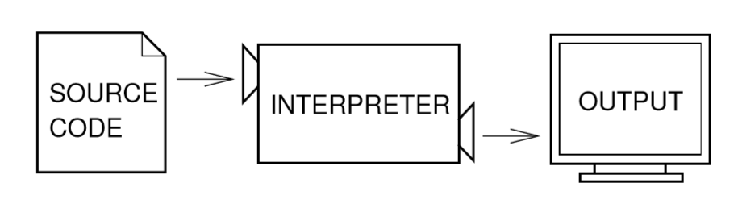
Interpreters

Slide 34
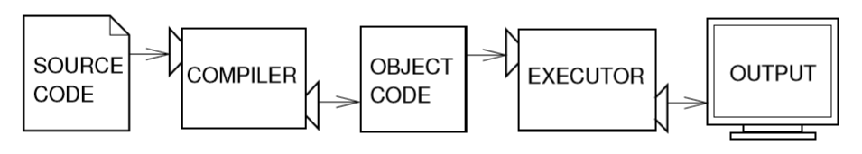
Compilers

Slide 35
Introduction
Python is :
High-level programming language.
Fast to learn and fast to develop application.
Available for many platforms.
Implement complex logic with very few lines of code.

Slide 36
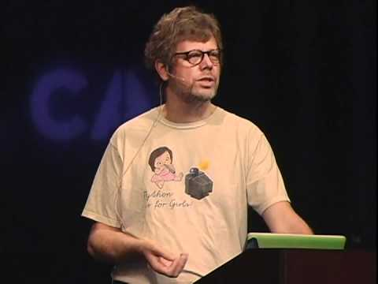
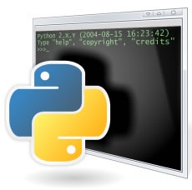

History
Guido van Rossum
At National Research Institute for Mathematics and Computer Science in Netherland.

Slide 37
Why One Should use PYTHON ?
What can I do in PYTHON

Slide 38
WHY ?

Slide 39
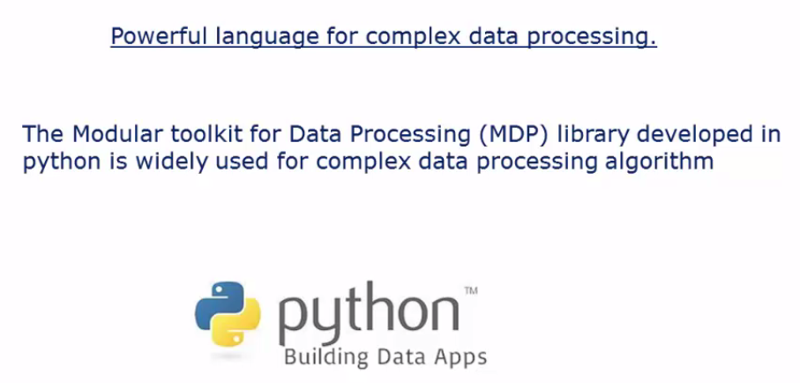
Data Processing

Slide 40
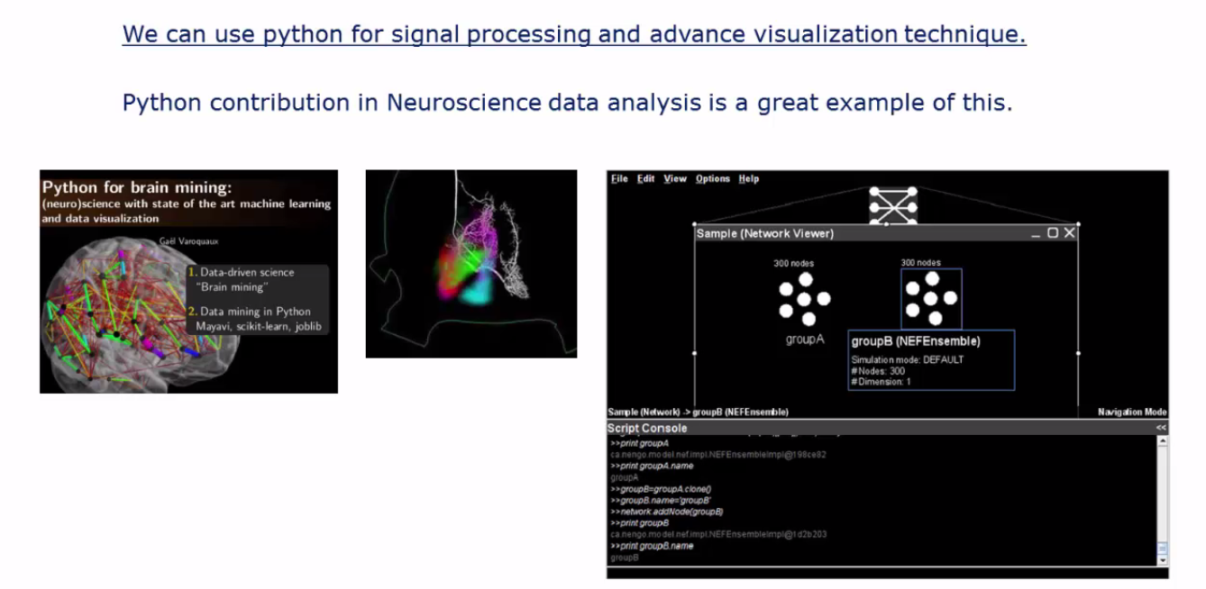
Signal Processing

Slide 41
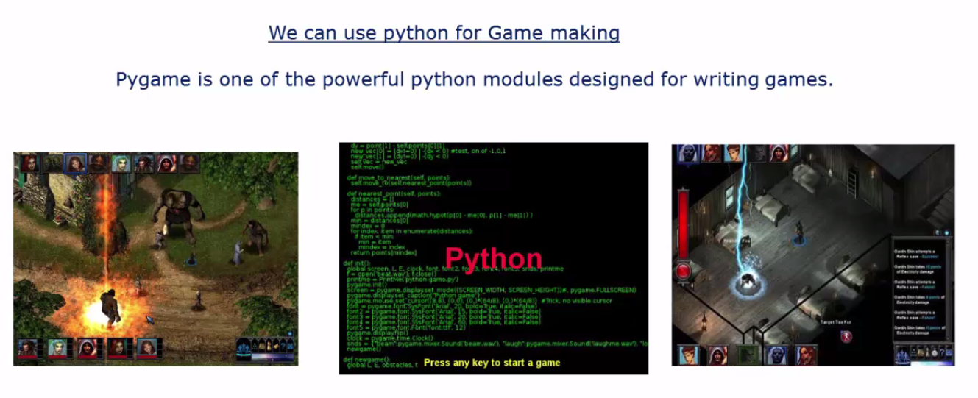
Pygame

Slide 42
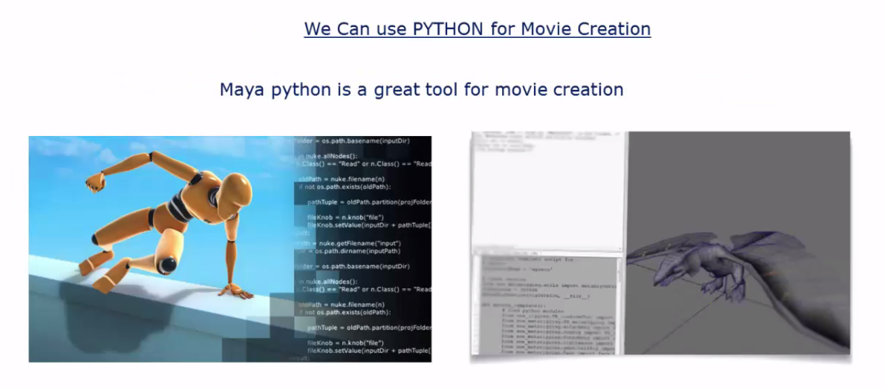
Maya Python

Slide 43
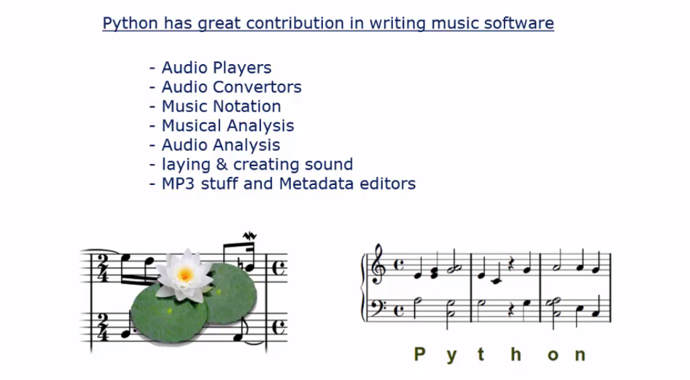
Music Software

Slide 44
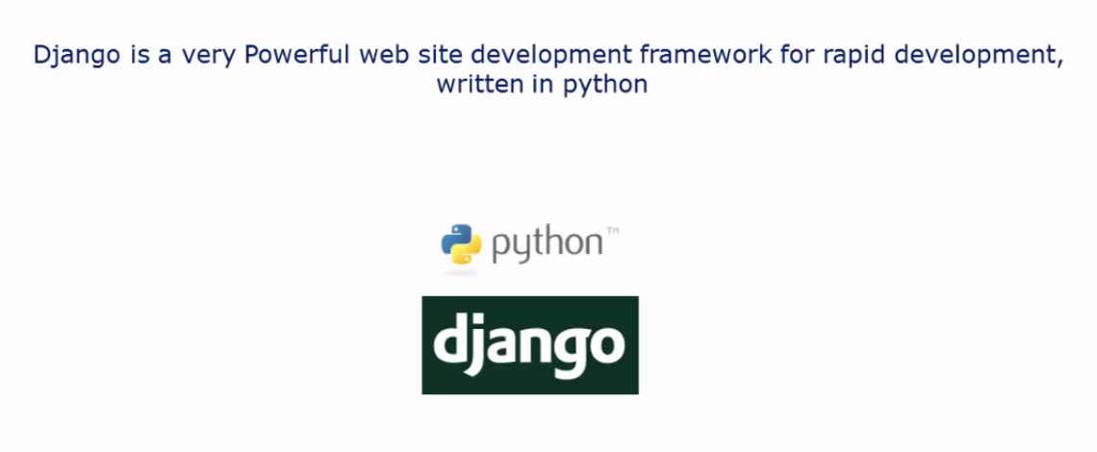
Web site development frame work

Slide 45
PYTHON 2 VS. PYTHON 3
Python 2 is legacy, Python 3 is the present and future.
Python 3 was released in 2008.
Python 3 don’t have enough libraries.
That’s why python 2 is present and still ON.

Slide 46
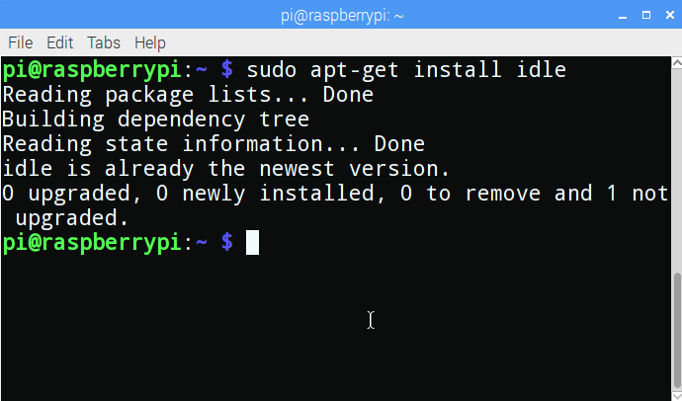
Installation
sudo apt-get install idle

Slide 47
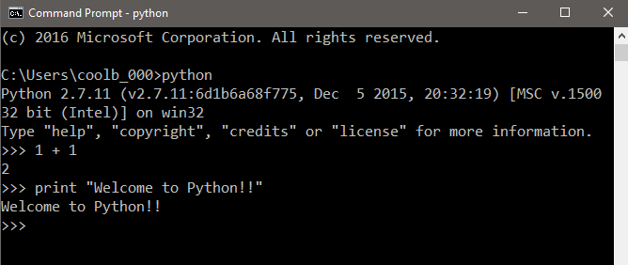
Two ways to use interpreter
1. Interactive Mode :

Slide 48
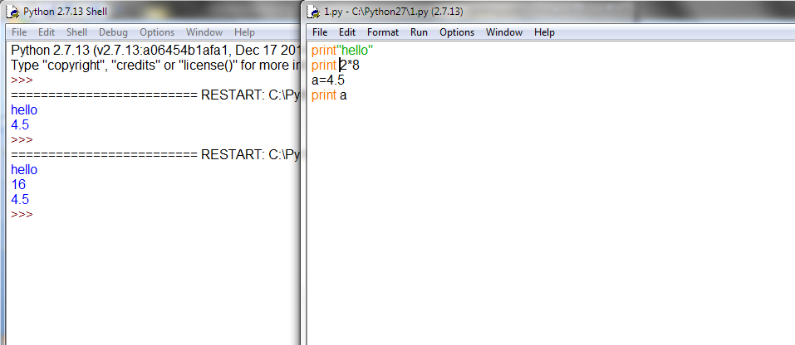
2. Script Mode (IDLE):
Store code in a file ending .py

Slide 49
Interpreter
execution = interpreter (bytecode)
or
give life to your code

Slide 50


Slide 51
A Layer software logic.
CODE
Interpreter
Computer
Hardware.

Slide 52
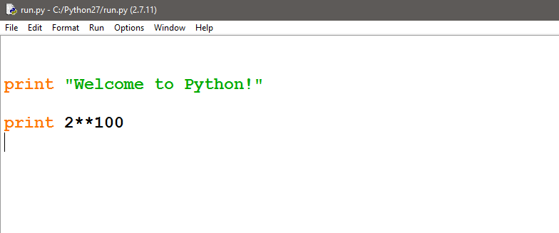
For example..

Slide 53
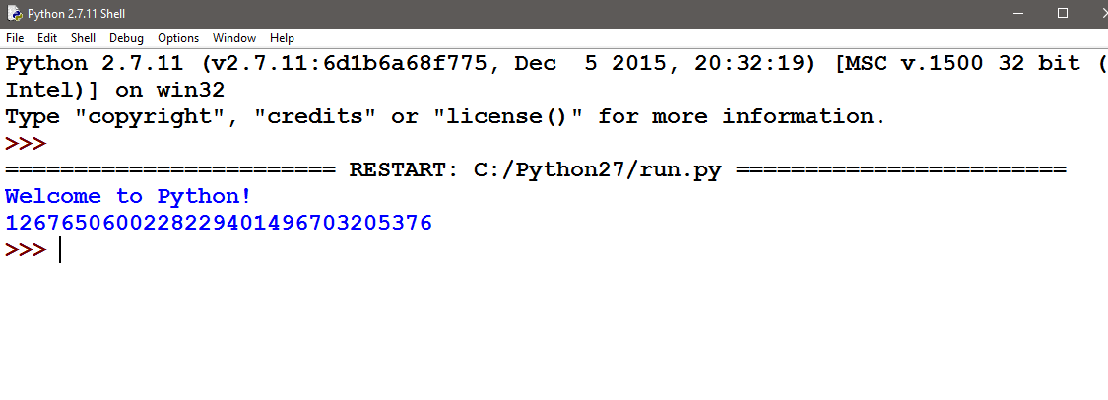
The Programmer’s View

Slide 54
Python’ View
Source
Byte code
Runtime
m.py
m.pyc
PVM
Python Virtual Machine (PVM)
Runtime execution model

Slide 55
What is debugging?
Types of errors occur while programming :
Syntax Error
Runtime Error
Semantic Error

Slide 56
Follow us on:
Instagram--https://instagram.com/pantechelearning?igshid=1fohp030onteu
Telegram--https://t.me/pantechelearning
YouTube--https://youtube.com/c/PantecheLearning.
Podcasts--https://www.instagram.com/tv/COPQIigJZFi/?igshid=4gjhz4dlls1p

Slide 57
THANKS
Further Information:
Senthil Kumar – 98409 74406
Srinivasan – 7010888841
Kumarasamy - 8925533489
www.pantechelearning.com | training@pantechmail.com

